Slide 1
Digital Signal Processors
Introduction to
Ref.: Steven W. Smith, “The Scientist and Engineer’s Practical guide to Digital Signal Processing”, California Technical Publishing, 1999.

Slide 2
Agenda
How DSPs are different?
Circular Buffering
DSP Architecture
Fixed vs Floating point
How Fast are DSPs?
DSP Market
Selecting DSPs
DSP Architectures:
TMS320C50
TMS320C54x

Slide 3
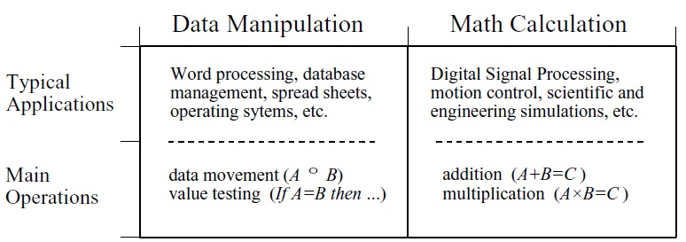
How DSPs are different?
Computers are extremely capable in two areas:
Data Manipulation
Mathematical Calculation
All µPs perform both tasks; but cannot be optimized for both.
Technical trade-offs: Size of instruction sets, interrupts, etc,.
Market issues: Cost, lifetime, etc,.

Slide 4
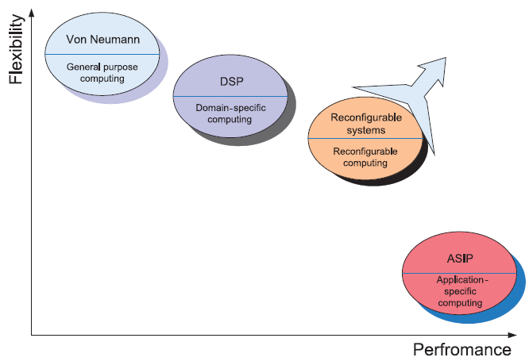
How DSPs are different?

Slide 5
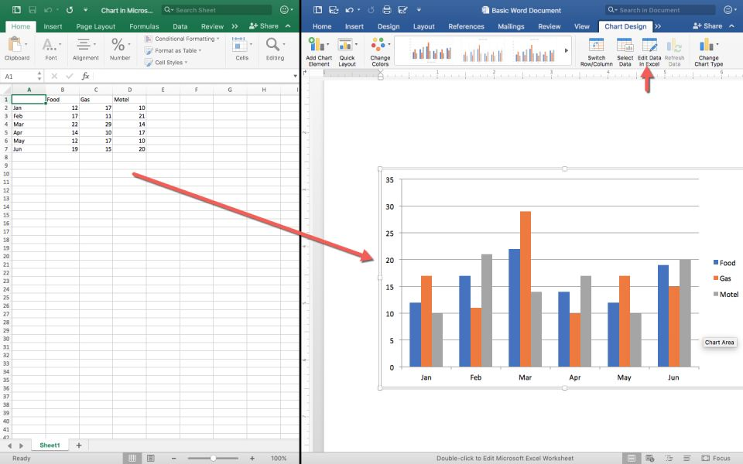
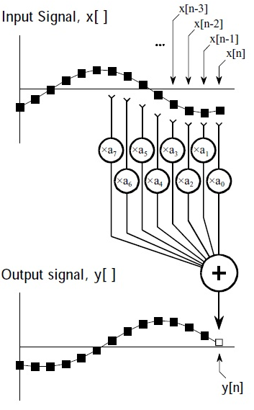

How DSPs are different?

Slide 6
How DSPs are different?
In addition to mathematical calculations, each DSPs must have predictable execution time.
Continuous processing
As Speed increases,
Cost
Power Consumption
Design complexity increases
DSP supports:
High performance
Repetitive
Numerically intensive tasks.

Slide 7
Circular Buffering
DSPs are constructed to quickly carry out FIR filters and similar techniques.
Understanding hardware requires the understanding of algorithms.
Off-line processing
Entire input signal resides in the computer at the same time
Ex. Seisometer, Medical imaging.
Real-time processing.
Output signal is produced at the same time while input signal is being acquired.
Ex. Telephone communication, Radar, Hearing aids.

Slide 8
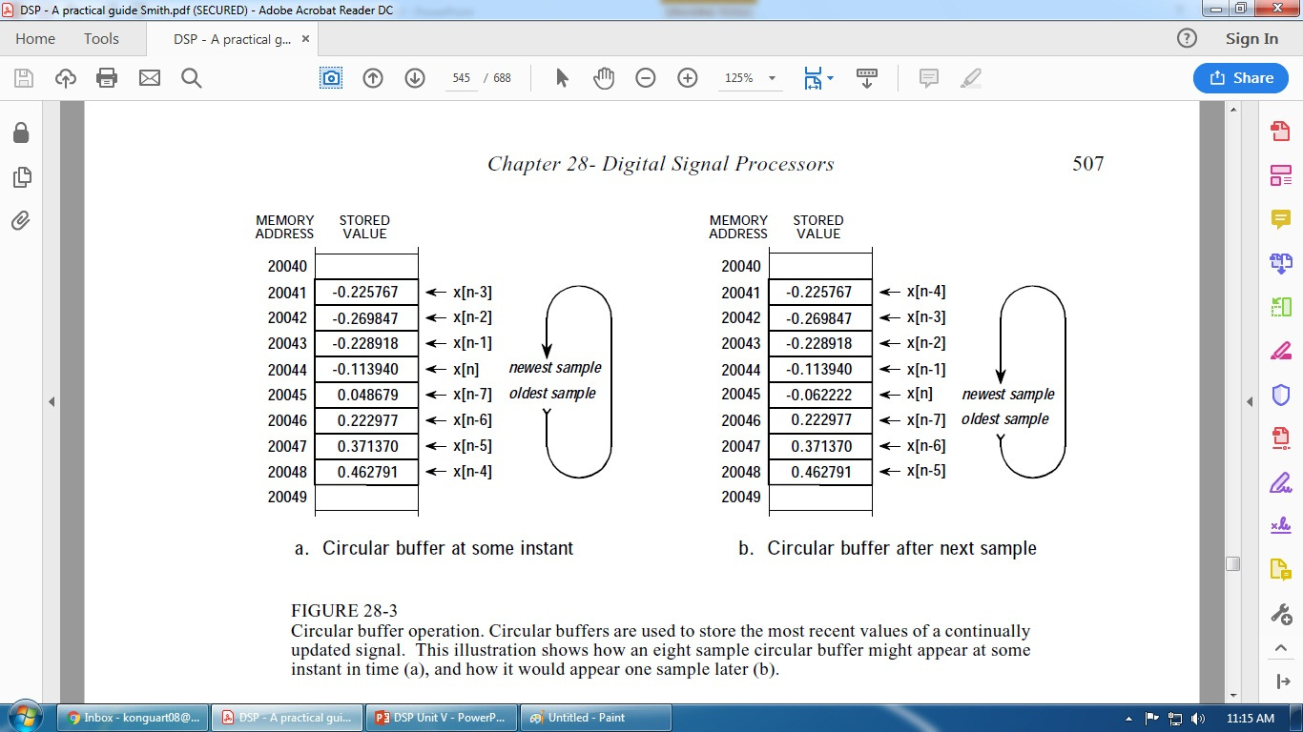
Circular Buffering

Slide 9
Circular Buffering
Parameters to manage Circular Buffering
Pointer that indicates start
Pointer that indicates end (or variable holding the length)
Step size
Pointer to the most recent sample.
First three defines the size and configuration of circular buffering.
A program logic must found for fourth pointer to be updated.
Circular buffering useful in off-line processing & critical in real-time processing.

Slide 10
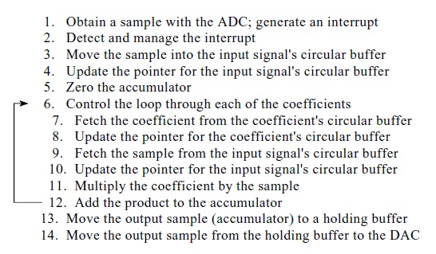
Circular Buffering for FIR – Steps:

Slide 11
DSP Architecture
One of the biggest bottlenecks in executing DSP algorithms is transferring information to and from memory.
This includes data, such as samples from the input signal and the filter coefficients, as well as program instructions, the binary codes that go into the program sequencer.
For example,
Multiplication of two numbers requires: Three binary values from memory, the numbers to be multiplied, plus the program instruction describing what to do.

Slide 12
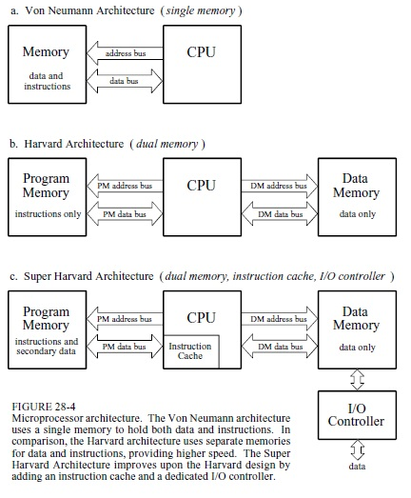
DSP Architecture

Slide 13
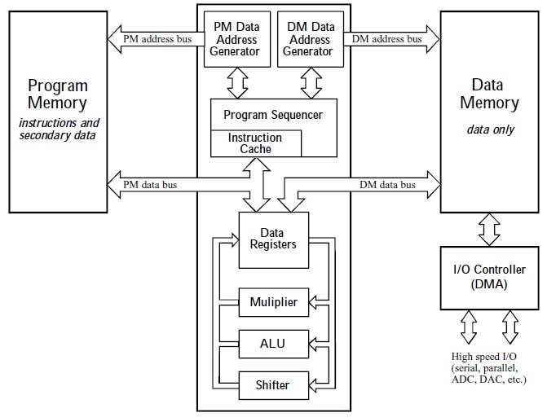
DSP Architecture

Slide 14
Fixed Vs. Floating Point
Format used to store and manipulate numbers within the devices.
Fixed point – 16 bits usually
2¹⁶ combinations of bit patterns. (65536)
Unsigned Integer: 0 to 65535.
Signed Integer: -32768 to +32767.
Unsigned fraction: 65536 spread uniformly between 0 and 1.
Signed fraction: Between –1 and +1.
Floating point – 32 bits.
2³² combinations. (4294967296).
Numbers are not uniformly spaced.
±3.4 X 10³⁸ and ±1.2 X 10⁻³⁸.
Smaller space between smaller numbers and vice-versa.

Slide 15
Fixed Vs. Floating Point
All floating point DSPs handle fixed point numbers, a necessity to implement
counters,
loops,
signals coming from the ADC and going to the DAC.
However, this doesn't mean that fixed point math will be carried out as quickly as the floating point operations; it depends on the internal architecture.
For instance, the SHARC DSPs are optimized for both floating point and fixed point operations, and executes them with equal efficiency, referred to as 32-bit DSPs, rather than just Floating Point.

Slide 16
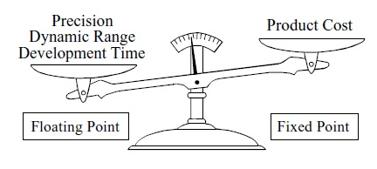
Fixed Vs. Floating Point
The internal architecture of a floating point DSP is more complicated than for a fixed point device.
All the registers and data buses must be 32 bits wide instead of only 16; the multiplier and ALU must be able to quickly perform floating point arithmetic, the instruction set must be larger (so that they can handle both floating and fixed point numbers), and so on.

Slide 17
Fixed Vs. Floating Point
Floating point (32 bit) has better precision and a higher dynamic range than fixed point (16 bit).
In addition, floating point programs often have a shorter development cycle, since the programmer doesn't generally need to worry about issues such as overflow, underflow, and round-off error.
On the other hand, fixed point DSPs have traditionally been cheaper than floating point devices.
Performance: What can a 32-bit floating point system do that a 16-bit fixed point can't? Signal-to-noise ratio.
Each time we store a number in floating point notation, we add noise to the signal.

Slide 18
Fixed Vs. Floating Point
The same thing happens when a number is stored as a 16-bit fixed point value, except that the added noise is much worse.
Noise in signals is usually represented by its standard deviation. The signal-to-noise ratio for storing a floating point number is about 30 million to one, while for a fixed point number it is only about ten-thousand to one.
In other words, floating point has roughly 30,000 times less quantization noise than fixed point.
Extended precision accumulator in DSP.
For example, in a 16 bit DSP it may have 32 to 40 bits, while in the SHARC DSPs it contains 80 bits for fixed point use.

Slide 19
Fixed Vs. Floating Point
In addition to having lower quantization noise, floating point systems are also easier to develop algorithms for.
Most DSP techniques are based on repeated multiplications and additions.
In fixed point, the possibility of an overflow or underflow needs to be considered after each operation.
The programmer needs to continually understand the amplitude of the numbers, how the quantization errors are accumulating, and what scaling needs to take place.
In comparison, these issues do not arise in floating point; the numbers take care of themselves (except in rare cases).

Slide 20
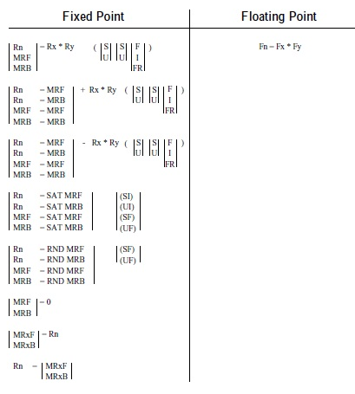
Fixed Vs. Floating Point
Multiplication:
Floating Point:
Fn = Fx * Fy, where Fn, Fx, and Fy are any of the 16 data registers.
Fixed Point:
Rn, Rx, and Ry refer to any of the 16 data registers.
MRF and MRB are 80 bit accumulators
Signed or Unsigned (S or U).
The RND and SAT options are ways of controlling rounding and register overflow.

Slide 21
Fixed Vs. Floating Point
Given these tradeoffs between fixed and floating point, how do you choose which to use? Here are some things to consider.
First, look at how many bits are used in the ADC and DAC. In many applications, 12-14 bits per sample is the crossover for using fixed versus floating point. For instance, television and other video signals typically use 8 bit ADC and DAC, and the precision of fixed point is acceptable.
In comparison, professional audio applications can sample with as high as 20 or 24 bits, and almost certainly need floating point to capture the large dynamic range.
Complexity of the algorithm: If it is relatively simple, think fixed point; if it is more complicated, think floating point.
Cost of the algorithm.

Slide 22
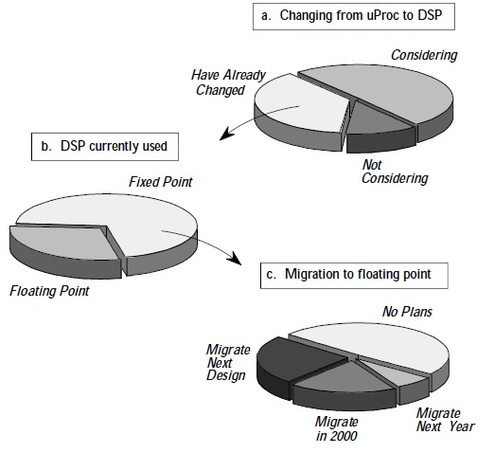
Fixed Vs. Floating Point
DSP Trends:

Slide 23
How Fast are DSP?
The primary reason for using a DSP instead of a traditional microprocessor is speed, the ability to move samples into the device, carry out the needed mathematical operations, and output the processed data.
How fast are DSPs?
Benchmarks.
For instance, Fixed point systems in MIPS (million integer operations per second). Floating point devices in MFLOPS (million floating point operations per second).
The idea behind benchmarks is to provide a head-to-head comparison to show which is the best device.

Slide 24
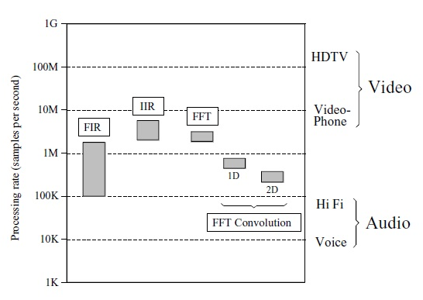
How Fast are DSP?

Slide 25

How Fast are DSP?
Multi-Processing systems:

Slide 26

How Fast are DSP?
Multi-Processing Mesh Configuration Systems:

Slide 27
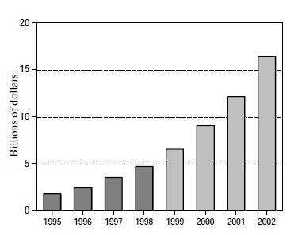
DSP Market
Purchase:
Core
Processor
Boards

Slide 28
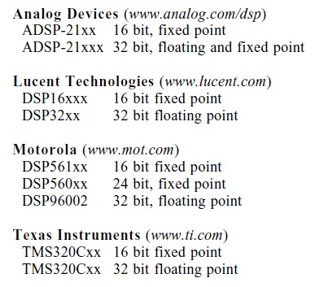
DSP Market

Slide 29
Selecting DSPs
Factors affecting the selection of DSP processor for any given application:
Architectural Features
On-Chip Memory
Special instructions
I/O capability.
Execution Speed
Types of arithmetic
Fixed point
Floating point
Word length
8/16/32 or any

Slide 30
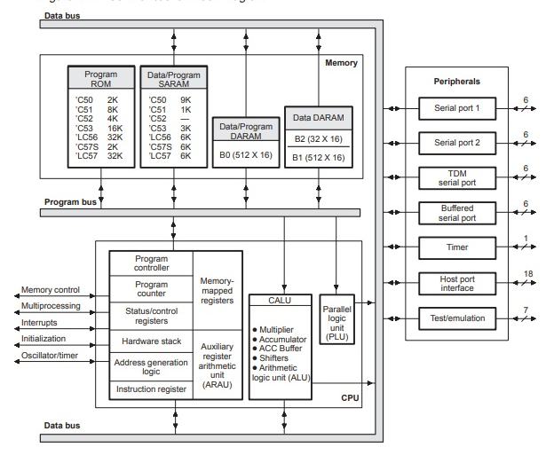
DSP Architectures: TMS320C50

Slide 31
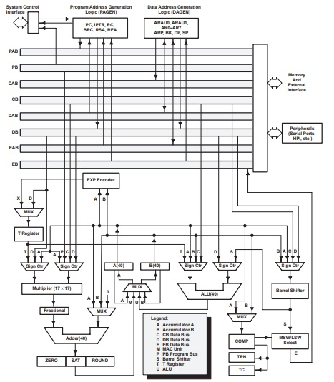
DSP Architectures: TMS320C54x

Slide 32
Thank you

